Slide 1
Title page
My name

Slide 2
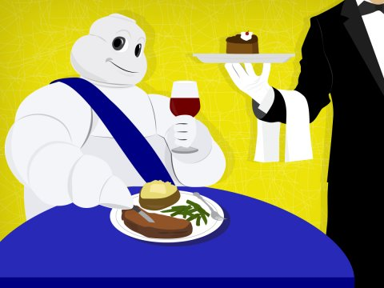
Michelin D.C. Predictions
By: Sam Stack

Slide 3
Tired of all this food talk?
Legend has it that long ago, In an attempt to spur travel, Michelin created a list of restaurants that were worth travelling to. Any normal business would try to game these restaurants to encourage maximum travelling (and thus travel more and spend more on tires). Michelin instead created an actually honest and elite list that soon developed into a ‘who’s who’ of dining.

Slide 4
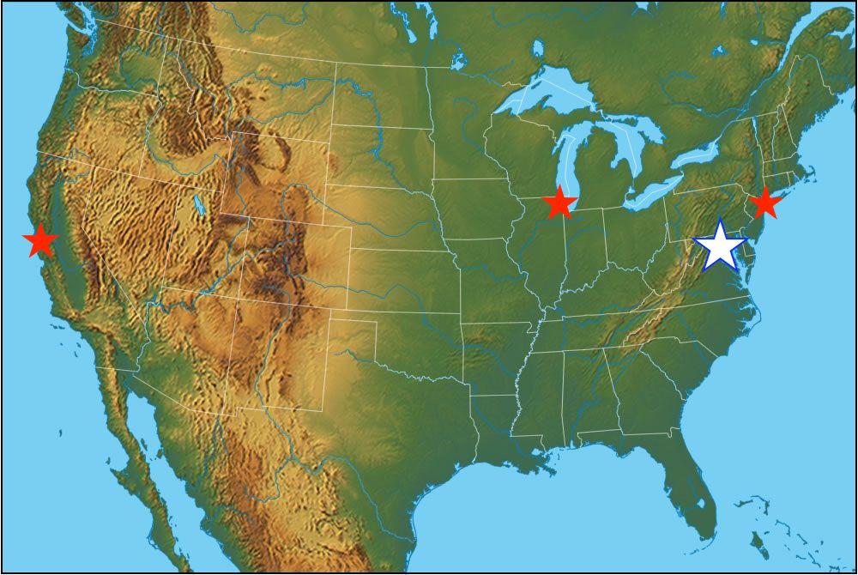
Michelin’s next stop
Washington D.C. will become the fourth current city in the United States to have Michelin reviewed restaurants.
People really want to know who the “who’s who” will be.
Tension so thick you can cut it with a knife.
If only Data Science could help…

Slide 5
What can data science do?
Acquire data from the internet.
Clean data
Build a model and optimize
Predict a list of restaurants and their stars.

Slide 6
Getting a Table
Scraped Reviews from Michelin.
https://www.viamichelin.com/web/Restaurants
Scraped Reviews from The Washingtonian
https://www.washingtonian.com/2016/02/08/100-very-best-restaurants/

Slide 7
Is this Table O.K.?
Pros.
Restaurants have similar review structures in both locations.
Observation noise severely reduced.
Cons.
Washingtonian Writer’s bias
Michelin’s Variance

Slide 10
Appetizer
Price, Type & Review
TFIDF (Term Frequency Inverse Document Frequency)
Measures how important I word is to a particular observation as well as across the entire corpus.
Train and Test needed to be combined for these steps and then split to maintain consistent features.

Slide 11
Cocktails
Random Forest Feature Selection
None of the features turned out to be significant in any way.
Took to feature selections.
250 of the ‘most important’ features.
Only features with an importance > 0 (14,000+)
Models with selected features performed much worse than models using all the features.
‘Cocktails were sent back.’

Slide 12
Entre
Initially a predicted probability looked appetizing as thresholds could be set to allow for classification.
i.e. < %50 = 0 | %50-75 = 1 | %75-90 = 2 | >%90 = 3
Logistic Regression & Support Vector Machine Classifier
Upon sampling there did not seem to be an kind of credible trend to base this judgment off.
K Nearest Neighbors Classifier Seemed to be a solid second option.

Slide 13
Confusion Matrix Scoring
 | Pred. 0 | Pred. 1 | Pred. 2 | Pred. 3
True 0 | NA | -0.5 | -1 | -1
True 1 | -0.5 | 1 | 0.5 | 0.5
True 2 | -1 | 0.5 | 2 | 0.5
True 3 | -1 | 0.5 | 0.5 | 3

Slide 14
Dessert
The Chocolate Cake of optimization… GridSearchCV
Extremely Computationally Expensive
Needed to use Amazon Web Services to calculate
Spurred side project to build a model to estimate how long a GridSearch will take.
Models using GridSearches Optimal Parameters did not perform better (nor worse).

Slide 15
The Bill
There is not a restaurant in D.C. (my test data) that is deserving of more than 1 Michelin Star.
Fiola Mare
Masseri
Fiola
Obelisk
Preserve
Del Campo
Woodberry Kitchen
Centrolina

Slide 16
The Review
My Model not wanting to predict any restaurant as a 2 or 3 was a big disappointment, but it could be right.
Would like to experiment with out classification model.
Possibly a Neural Network
Use the same medium(s) for all reviews for consistency.
Get dummies can be used to express having multiple cuisine types.
Build a model that just analyzes the Photos of the food.

